Slide 1
Trekr
Jonathan Harris, Derek Kidd, Ethan McKenzie, Ryan Thomas
Notes:
All, then Derek

Slide 2
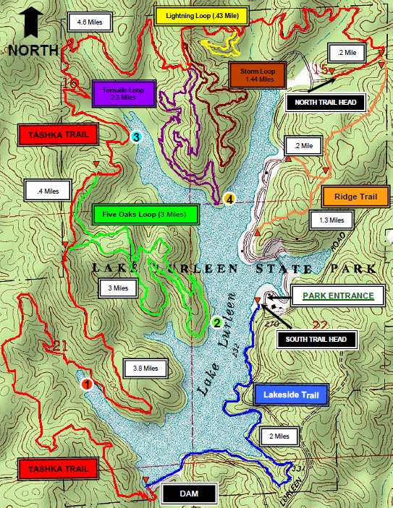
Problem Definition
Physical maps are typically maintained by a park association or volunteer group which tends to lead to maps that are out of date
Physical maps require frequent effort to maintain
Users of the trails are unable to provide updates or mark interesting points on a trail
User location on map may be hard to determine without the use of technology.
Notes:
Ethan

Slide 3

Scope
Our target users include hikers, mountain bikers, geocachers, and outdoor enthusiast
Family and friends of the target users benefit from the emergency feature
Trekr provides a dynamic system for trails and points of interest
Users do not have to wait for trail updates from a park association or volunteer group
Users are able to precisely determine their geographical location as well as relation to other trails and points of interest
Notes:
Jonathan

Slide 4
Use Case Diagram
Notes:
Ryan

Slide 5
Class Diagrams
Notes:
Jonathan

Slide 6
Activity Diagram
Add Trail
Notes:
Derek

Slide 7
Activity Diagram
Select Trail/POI
Notes:
Derek

Slide 8
Activity Diagram
Add/Edit POI
Notes:
Ethan

Slide 9
Activity Diagram
Backtrack
Notes:
Ethan

Slide 10
Activity Diagram
Emergency Mode
Notes:
Ryan

Slide 11
Activity Diagram
Search Trail/POI
Notes:
Ryan

Slide 12
Features
Name | Priority
View Trails | Required
View Points of Interest | Required
Emergency Mode | Required
Add/Edit Trails | Required
Add/Edit Points of Interest | Required
Point to Nearest Trail | Possible
Backtrack | Possible
Search | Possible
User Accounts | Future Work
Navigate Trails | Future Work
Weather Integration | Future Work
Notes:
Jonathan

Slide 13
Potential Risks
Issues with time constraints from other courses
Difficulties with Android Studio and the Android SDK
Overly ambitious goals
Distance collaboration and synchronization
Task delegation among group members
Ensuring all group members maintain the same end goal
Notes:
Ethan

Slide 14
Summary
Notes:
Derek

